Slide 1
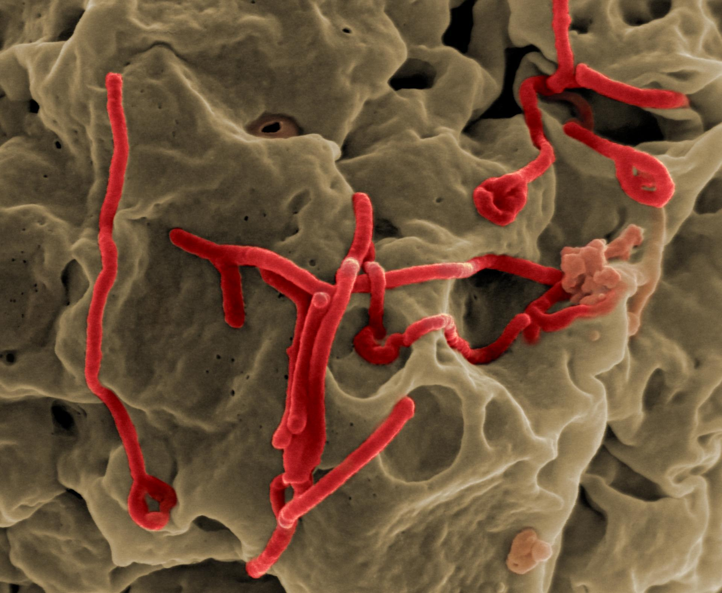
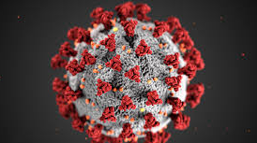

EBOLA TRANSMISSION AND SPREAD
Project guided by - Prof. Roshi Nilchiani
Project by -
Annie Renita and Gauri Mahajan

Slide 2
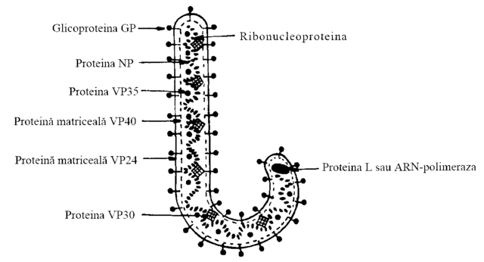
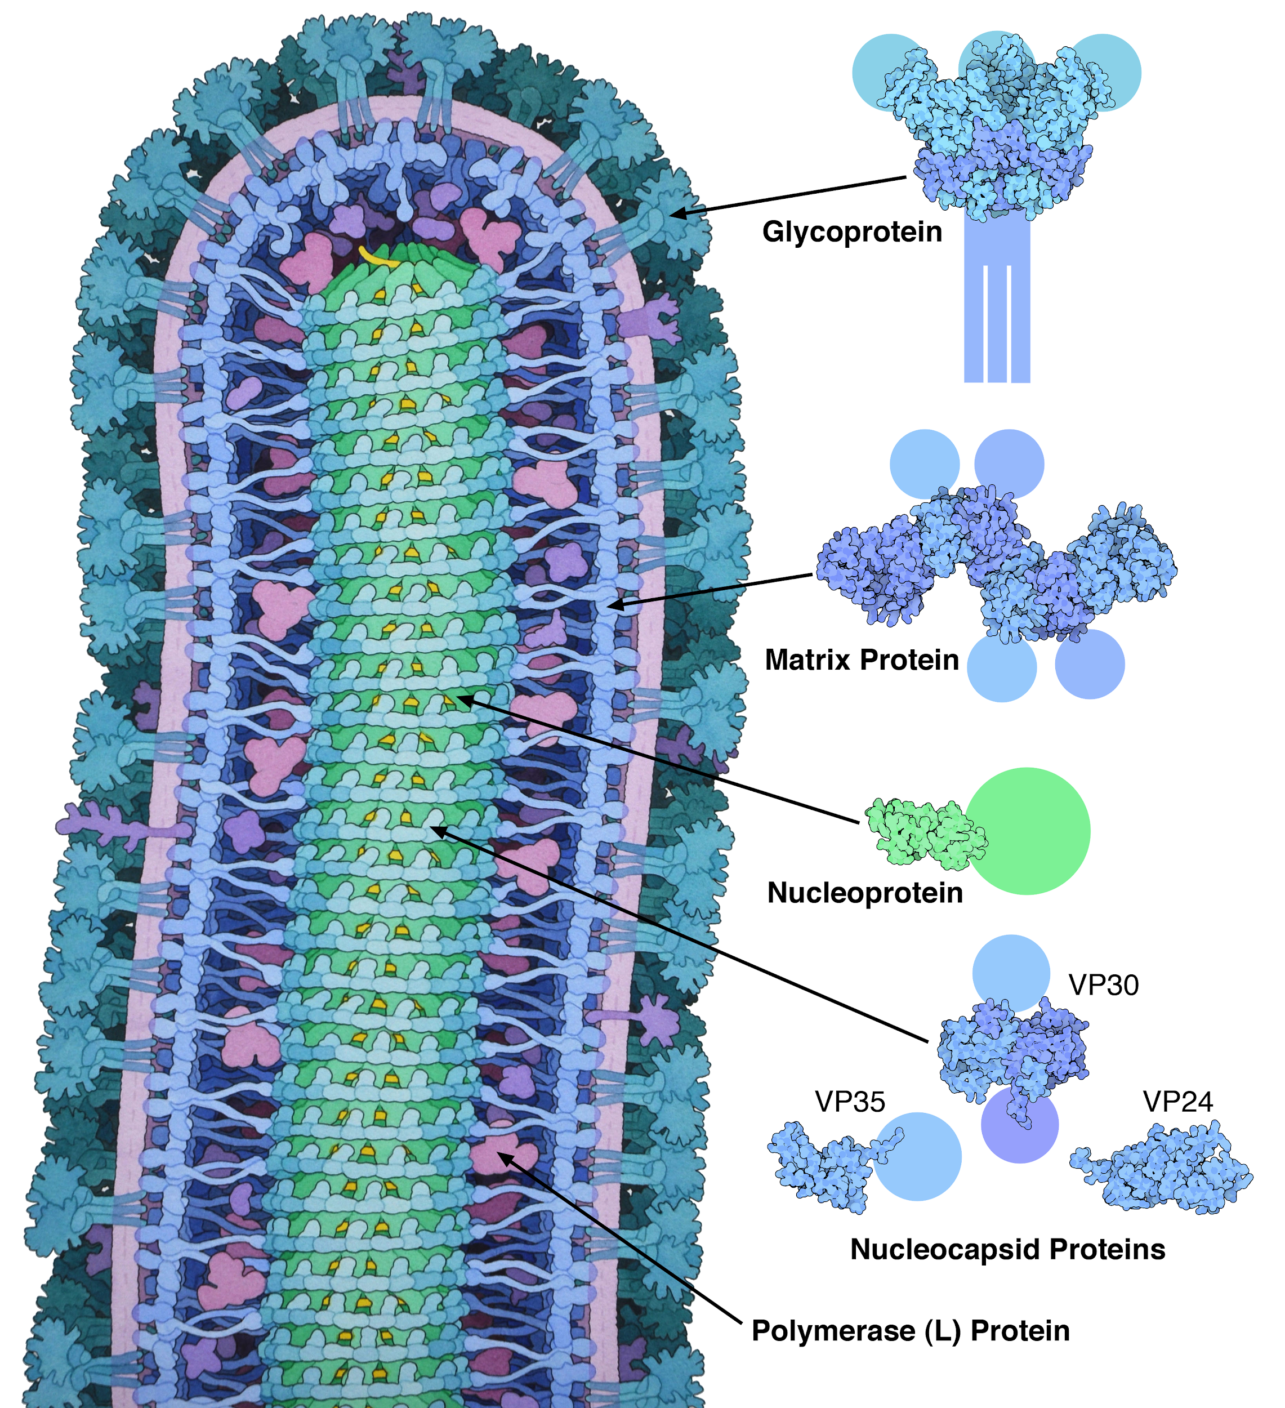
What is Ebola?
Ebola is a virus, NOT a bacterium, prion or eukaryote.
It has negative strand RNA and is 288 amino acids long.
Ebola causes severe Hemorrhagic fever.
causes an acute, serious illness which is often fatal if untreated.
Potential to be used in biological warfare.
The average EVD (Ebola Virus Disease) case fatality rate is around 50% but the case fatality rates have varied from 25% to 90% in the past outbreaks.

Slide 3
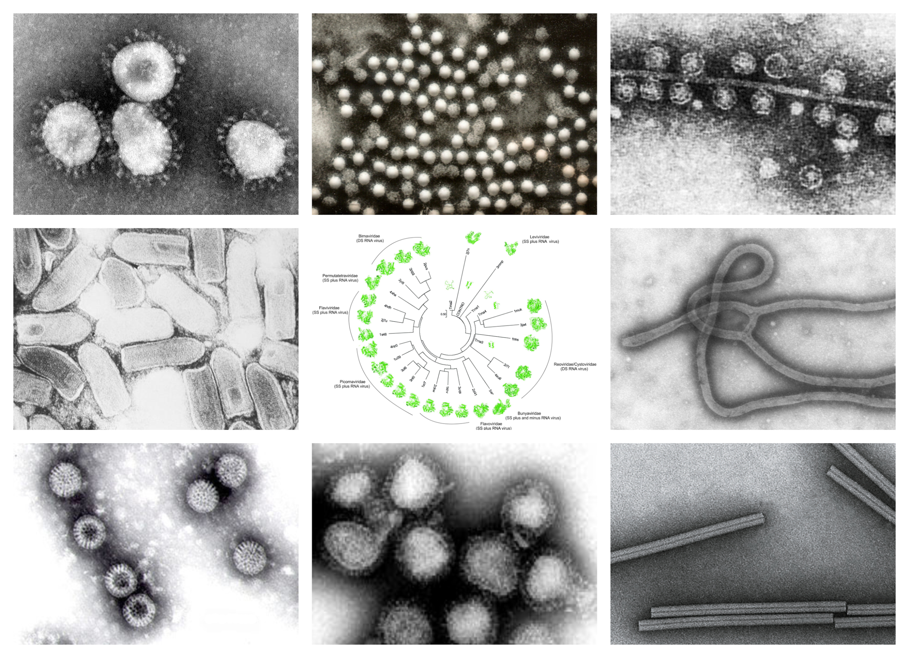
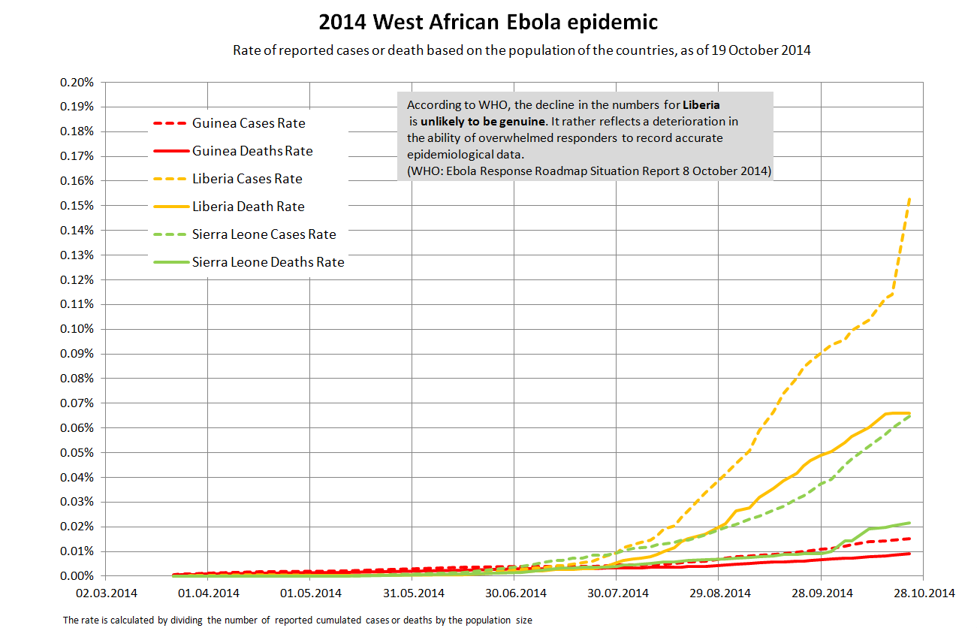
History & Background :
First discovered in 1976, 2 simultaneous outbreaks, one in Nzara, South Sudan, and the other in Yambuku, Democratic Republic of Congo.
Occurred in a village near the Ebola river.
Average EVD (Ebola Virus Disease) case fatality rate is around 50% but the case fatality rates have varied from 25% to 90% in the past outbreaks.
Virus family Filoviridae includes three genera: Cuevavirus, Marburgvirus and Ebolavirus. 6 species have been identified: Zaire, Bundibugyo, Sudan, Tai Forest, Reston and Bombali.
Fruit bats of the Pteropodidae family are suspected to be natural Ebola virus hosts.

Slide 4
History & Background ( ......... Continued)
Peter Piot, a microbiologist and physician who investigated the ensuing epidemic, concluded that it was inadvertently caused by the Sisters of Yambuku Mission Hospital, who had given unnecessary vitamin injections to pregnant women in their prenatal clinic without sterilizing the needles and syringes.
In 1976, 318 cases and 280 deaths in the outbreak ,lasted less than 11 weeks. In the West Africa outbreak, there were 11,310 deaths out of nearly 29,000 cases, and the epidemic lasted more than two years - almost 10 times as long as in 1976.
2014-2016 outbreak in West Africa was the largest Ebola outbreak. The outbreak started in Guinea and the moved across land borders to Sierra Leone and Liberia.
The most recent outbreak was in 2018-2021 had been detected in Butsii Health Area, Benii Health Zone in North Kivu Province.

Slide 5
Spread :
Ebola is spread to Humans by : direct contact with the blood, secretions, organs, or other body fluids of infected animals such as fruit bats, chimps, gorillas, monkeys, forest antelope, or porcupines that have been found sick or dead in the jungle.
Ebola transmits from person to person by direct contact (through damaged skin or mucous membranes) with: Blood or bodily fluids of an Ebola patient or a person who has died from Ebola. Objects contaminated with bodily fluids (such as blood, feces, or vomit) from an Ebola patient or the body of an Ebola patient who died.

Slide 6
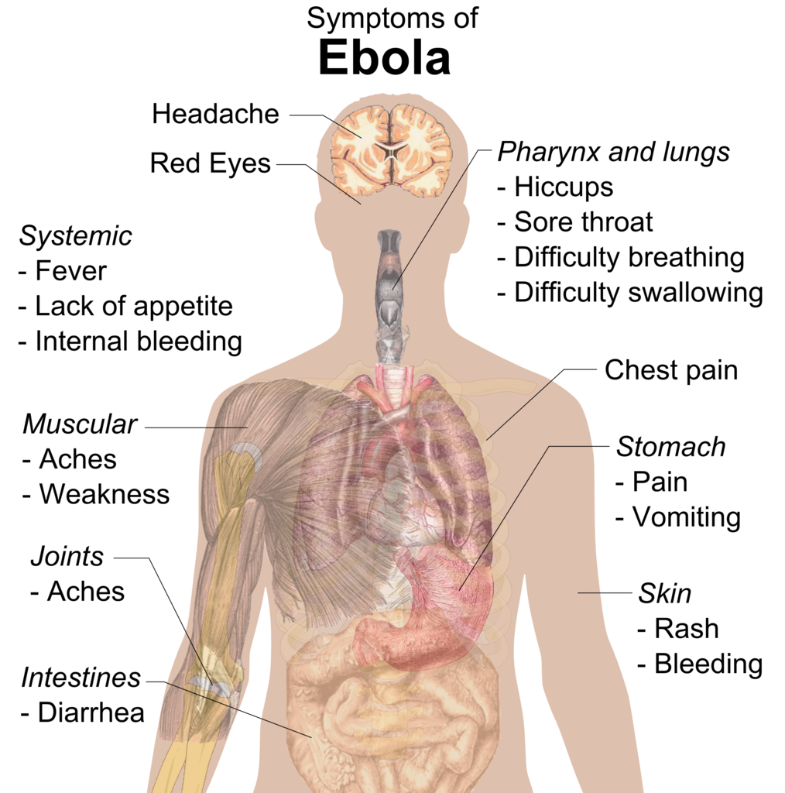
Symptoms :
The incubation period, or the time between viral infection and start of symptoms, ranges from 2 to 21 days. A person who has been infected with Ebola cannot spread the illness until symptoms appear.
EVD symptoms can appear suddenly and include: Fever, Fatigue, Muscle ache, Headache, Throat irritation.
The following comes after that: Vomiting, Diarrhoea and Rash, Symptoms of Kidney and Liver Insufficiency. Both internal and external bleeding can occur in some circumstances (for example, oozing from the gums, or blood in the stools). Low white blood cell and platelet counts, as well as increased liver enzymes, were discovered in the lab.

Slide 7


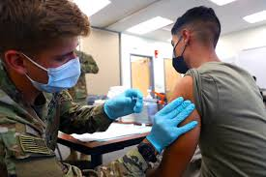
Treatment & Control:
First-ever multi-drug randomized control trial was conducted in the Democratic Republic of the Congo during the 2018-2020 Ebola outbreak .
In late 2020, the US Food and Drug Administration authorized two monoclonal antibodies (Inmazeb and Ebanga) for the treatment of Zaire ebolavirus (Ebolavirus) infection in adults and children. WHO prequalified it for use in anyone aged 18 and above (excluding pregnant and nursing women) for protection against Ebola virus illness.
Survival is improved with supportive care, such as rehydration with oral or intravenous fluids, and treatment of particular symptoms. Possible treatments are now being explored, including blood products, immunological therapy, and pharmacological therapies.

Slide 8


Objective / Interest of the project model:
To avoid disease spread in the future, it is necessary to have a risk management strategy ready, in-order to contain any disease. To create a risk management strategy and prevention & control of any disease it is necessary to have a dynamic model system to help analyze data of transmission and spread of the disease within the communities.
Most recent outbreak was in 2018-2021. The World Health Organization has acknowledged and Ministry of Health of Democratic Republic of Congo has confirmed cases of Ebola virus disease (EVD) so this means that EVD has not been completely eradicated so there’s a chance of EVD to cross borders and create an outbreak. Analyzing and studying the dynamic factors leading to the transmission and spread, would help in disease management.

Slide 9
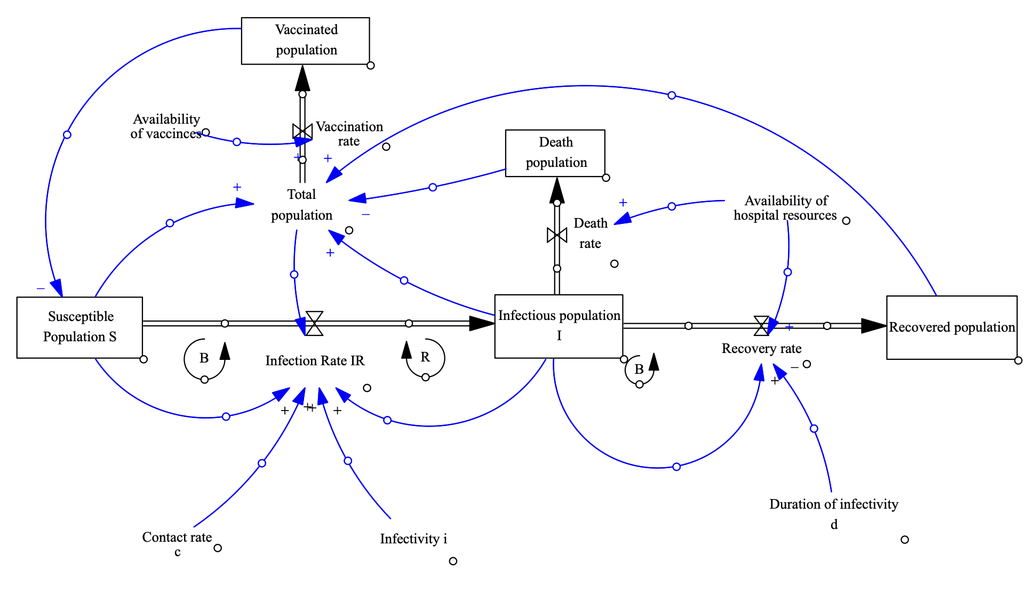
Dynamic Simulation model of Ebola transmission and control :

Slide 10
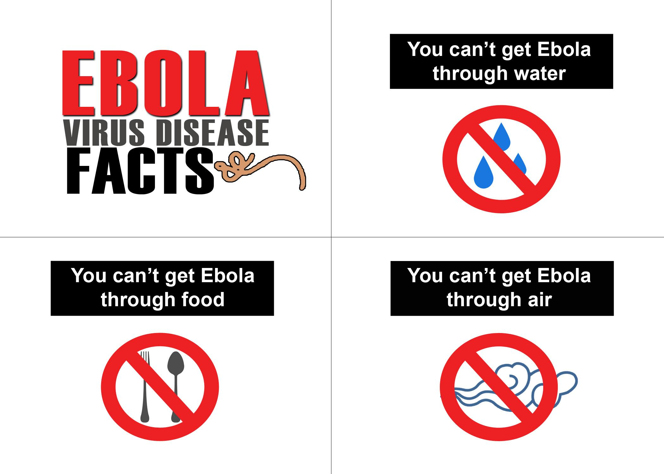
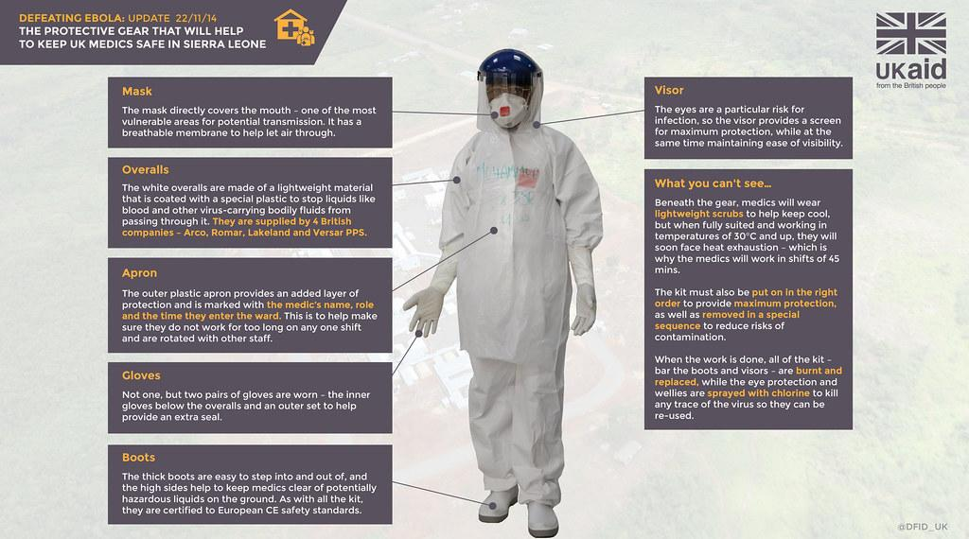
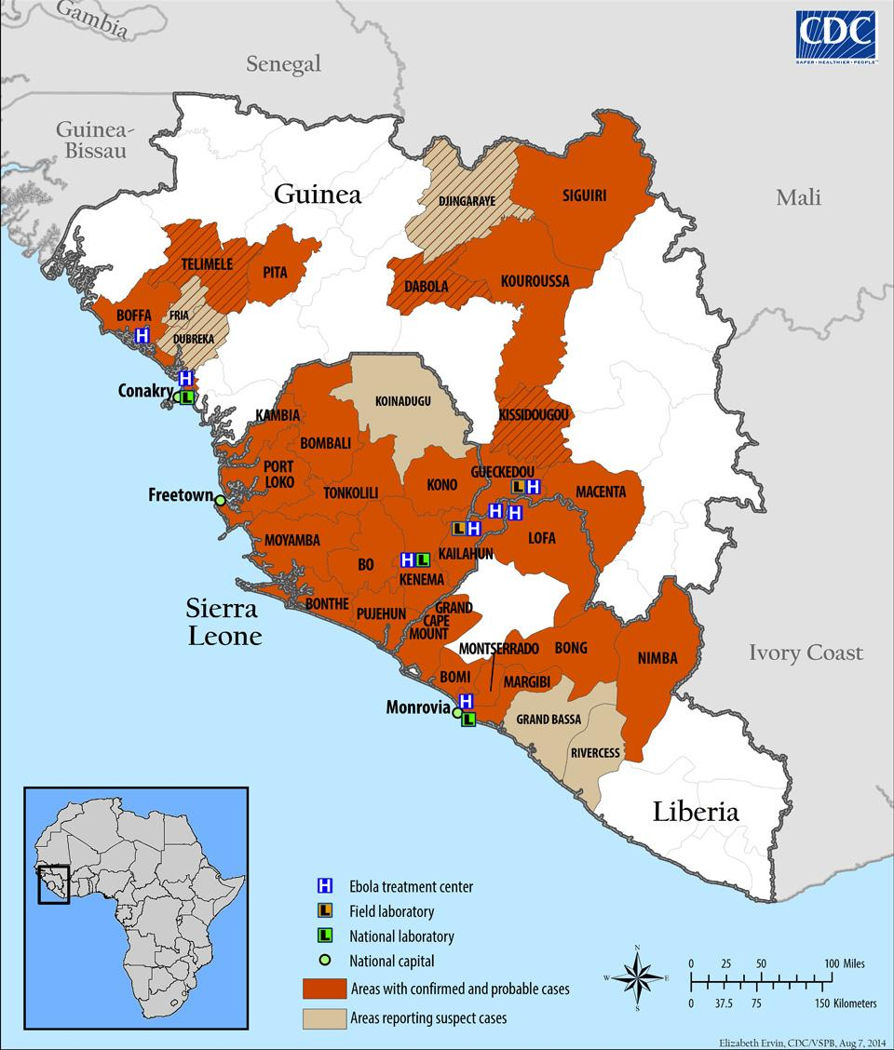
Questions ??

Slide 11
Thank You !!

